Slide 1

230 Java SL VA - Java Microservices - RLL - Group 2 PROJECT: HOSPITAL MANAGEMENT SYSTEM

Slide 2

GROUP-2
Akshay Kailassing Pardeshi 2563548 Anikit Sahoo 2563553 Kalpanasri Balasubramani 2563771 Kyama Shravya 2564324 Mandadi Harish 2563441 P Yamini 2563216 Rahul B P 2563033 Shalini Kothandaraman 2563581 Tushar Ranjan Nayak 2563267

Slide 3
CONTENTS
Introduction
Objectives
Tools & languages used
System Requirements
Features
Flow of Application
Future Scope & Improvement
Conclusion
Data Flow
Advantages
Working of Project
Postman testing

Slide 4
INTRODUCTION
The purpose of the project entitled as “HOSPITAL MANAGEMENT SYSTEM” is to computerize the Front Office Management of Hospital to develop software which is user friendly, simple, fast, and cost – effective. It deals with the collection of patient’s information, diagnosis details, etc.
It is accessible by an administrator. The data can be retrieved easily. The interface is very user-friendly.

Slide 5
The project Hospital Management system includes registration of patients, storing their details into the system, and also computerized invoice.
The software has the facility to give a unique id for every patient and stores the details of every patient and the staff automatically.
User can search availability of a doctor and the details of a patient using the id. The Hospital Management System can be entered using a username and password.

Slide 6

OBJECTIVE
Design a system for better patient care.
Reduce hospital operating costs.
Provide MIS report on demand to management for better decision making.
Better co-ordination among the different departments.
Provide top management a single point of control.
The Hospital Management System can be entered using a username and password.
Hospital Management System enables you to develop your organization and improve its effectiveness and quality of work.
Hospital Management Web application for managing inventory and laboratory management using java microservices architecture

Slide 7

TOOLS AND TECHNOLOGIES
Java microservices Architecture
Spring Boot, Spring Cloud, Spring Data JPA
MySQL
EmbeddedTomcat
Git Hub
Spring Cloud Config, Spring Cloud Netflix Eureka, Feign, Resilience4j, Retry, Sleuth and Zipkin.

Slide 8

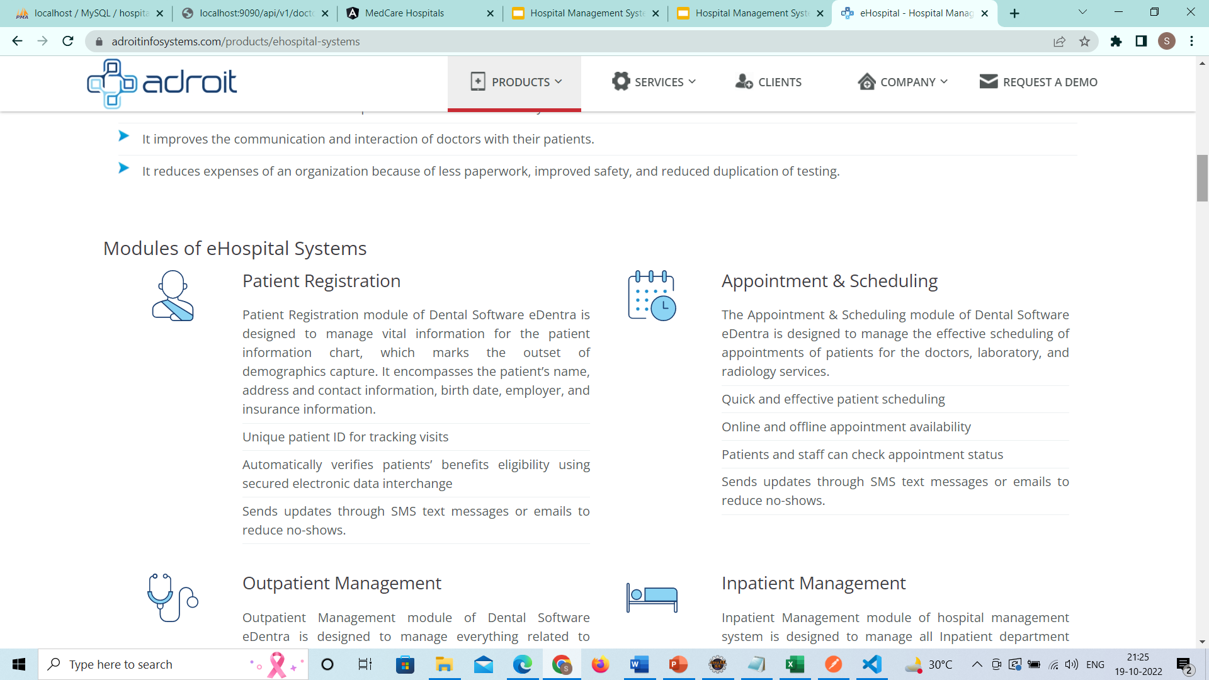
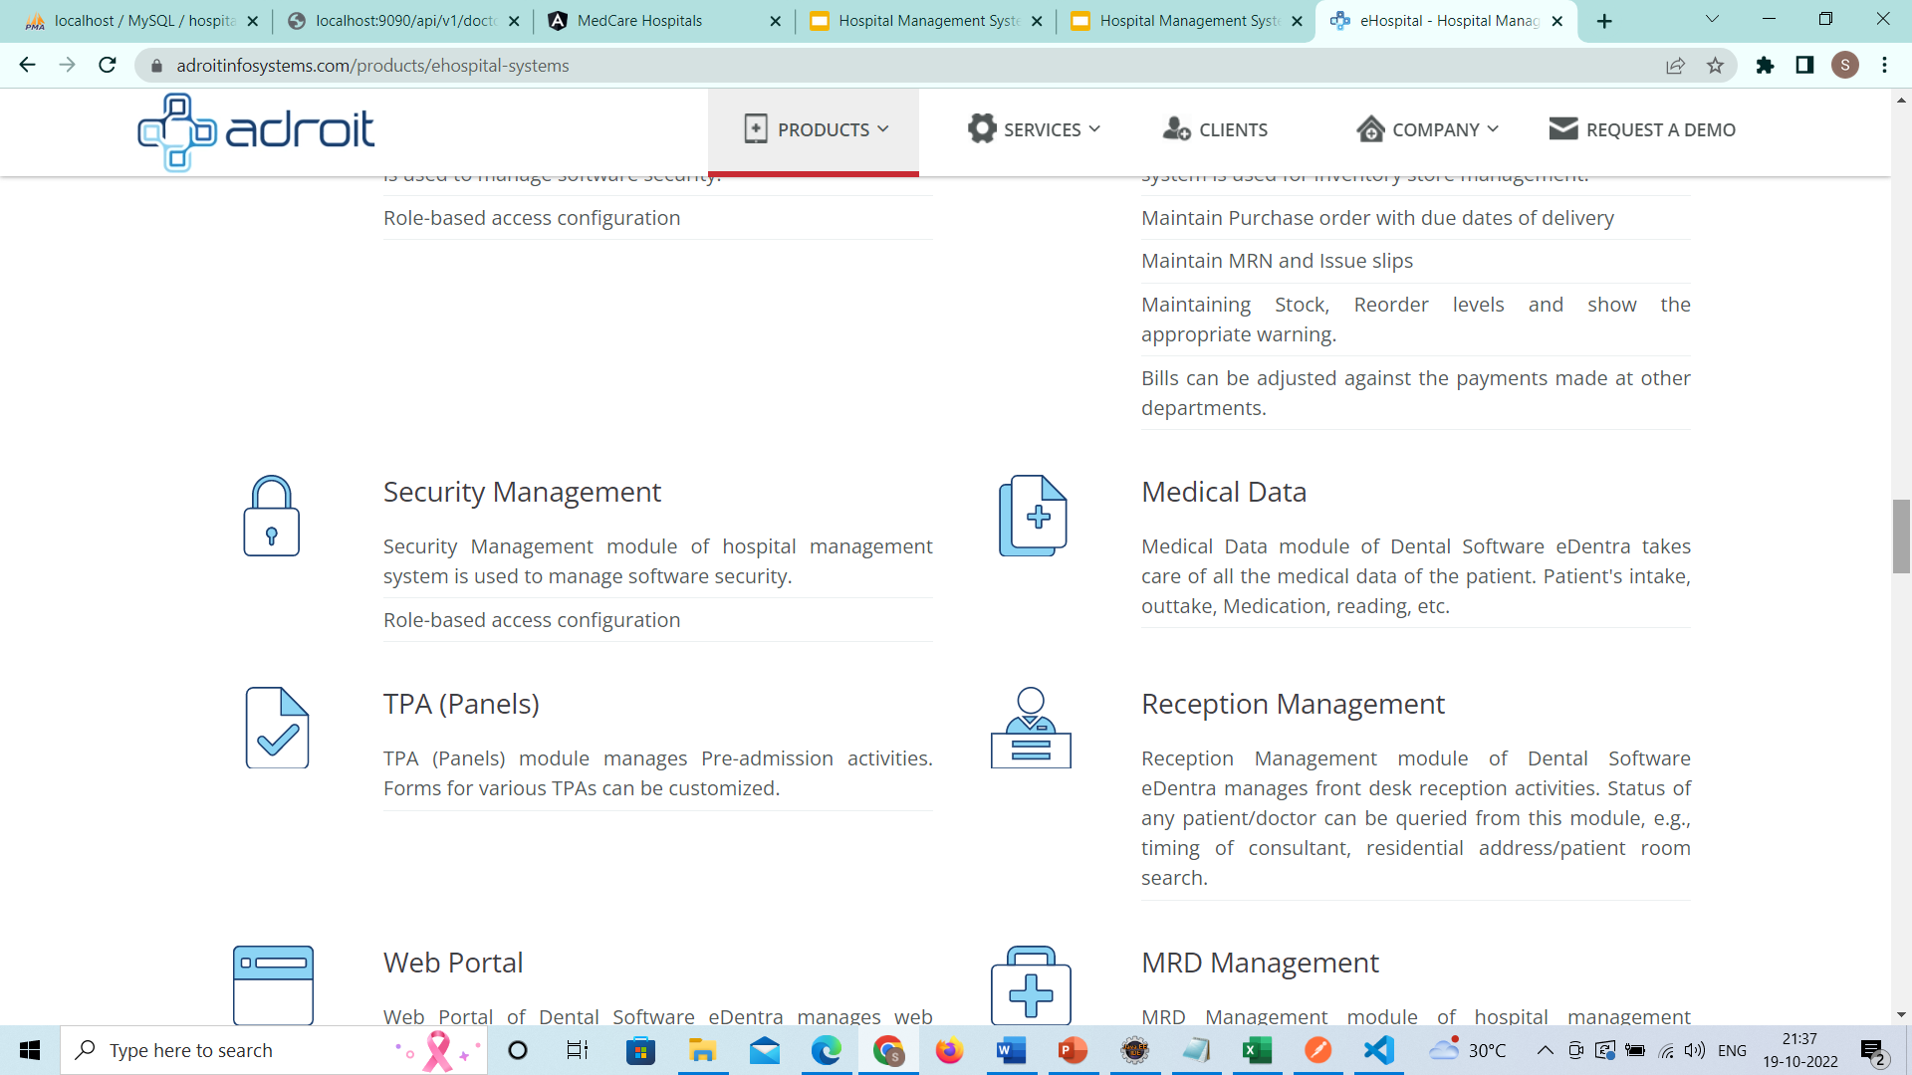
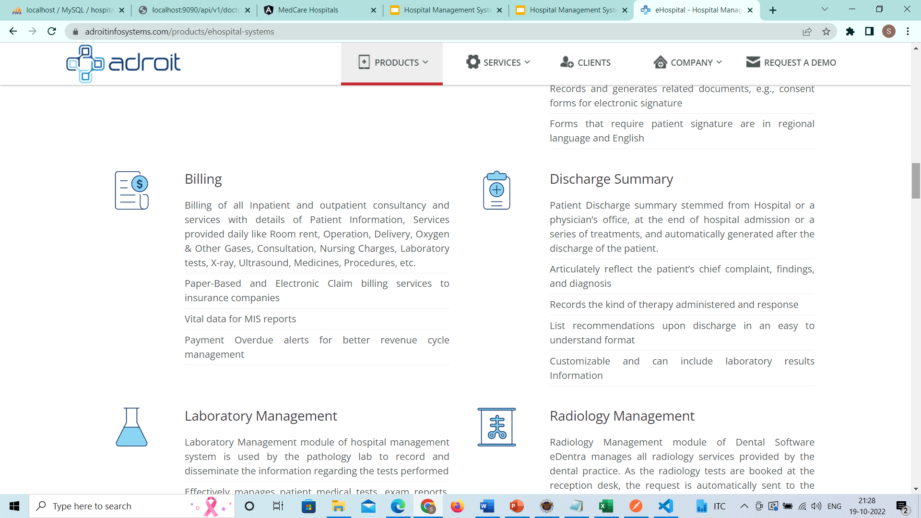
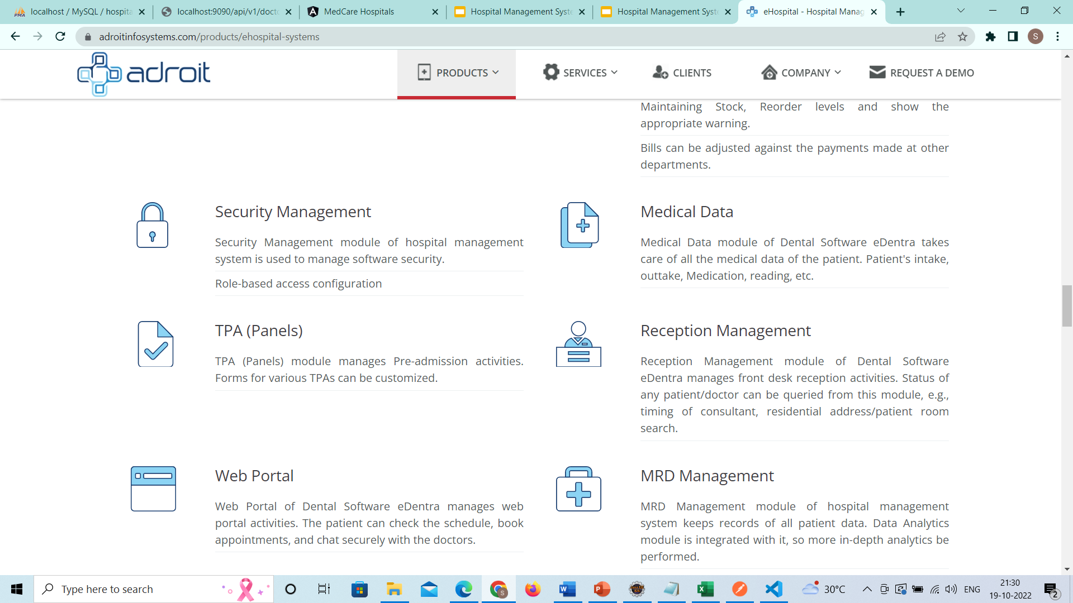
FEATURES
Patient Data Management
Appointment
Booking
Administrative
Operations
Doctor Data Management
Invoice Details Management
Medical Data

Slide 9

ADVANTAGES
Processing Speed & Results
Cost Effective Reduction
Reduction in Errors
Data Security & Retrieving Ability
Quality & Compliance
Improved Patient Care

Slide 10
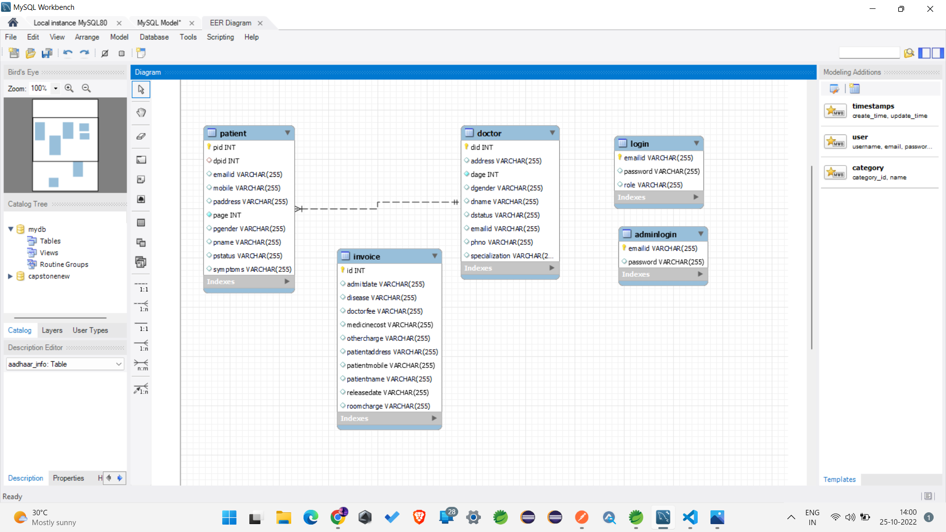
ENTITY RELATIONSHIP DIAGRAM

Slide 11
MODULES OF HOSPITAL MANAGEMENT SYSTEM
Admin Module
Doctor Module
Patient Module

Slide 12
ADMIN WORK FLOW
ADMIN
admit patient
Delete doctor
Approve doctor
Reject doctor
Register doctor
View all doctors
view patient
Approve patient
Reject patient
Discharge patient
Can generate invoice pdf
view appointments
approve appointments
book appointments

Slide 13
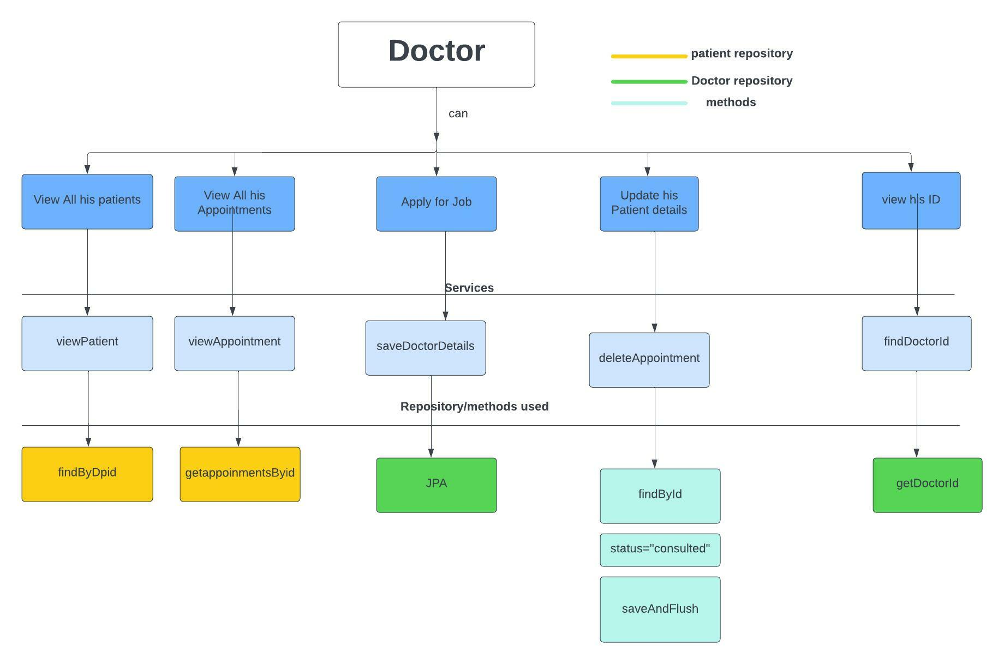
DOCTOR WORK FLOW

Slide 14
PATIENT WORK FLOW
Admit Patient
Apply job
Admin Signup
Admin Login
Patient Admission
Appoint Doctor
Assign Doctor Patient id| Doctor id
Patient Signup
Patient Login
View Status
Admin Login
Approve Doctor
Doctor Signup
Doctor Login

Slide 15


Slide 16

FUTURE SCOPE
The proposed system is Hospital Management System, the system include more facilities like pharmacy system for the stock details of medicines in the pharmacy.
They providing such features enable the users to include more comments into the system.

Slide 17

CONCLUSION
Hospital management systems allows us the ability to optimize and digitize all the processes within the institution.
It will help to improve customer service, reduce process costs, streamline the search of medical records, bills, patients, doctors, etc.
Hospital Management System will contributed enormously to better health and influenced the lives and well-being of billions of humans.

Slide 18


